Slide 1
Combinatorial Pyramids – Development and Lessons Learned
David Pfahler
Structural Pattern Recognition

Slide 2
Recap Combinatorial Maps

Slide 3
Recap Combinatorial Maps
 | 1 | 2 | 3 | 4
a | 2 | 1 | 4 | 3
s | 4 | 2 | 3 | 1

Slide 4
Recap Combinatorial Maps
 | 1 | 2 | 3 | 4
a | 2 | 1 | 4 | 3
s | 4 | 2 | 3 | 1

Slide 5
Development Phases
Phase 1:
Existing Work
Phase 2:
Meet the Maps
Phase 3:
Implementation
Phase 4:
Results

Slide 6
Development Phases
Phase 1:
Existing Work
Phase 2:
Meet the Maps
Phase 3:
Implementation
Phase 4:
Results

Slide 7


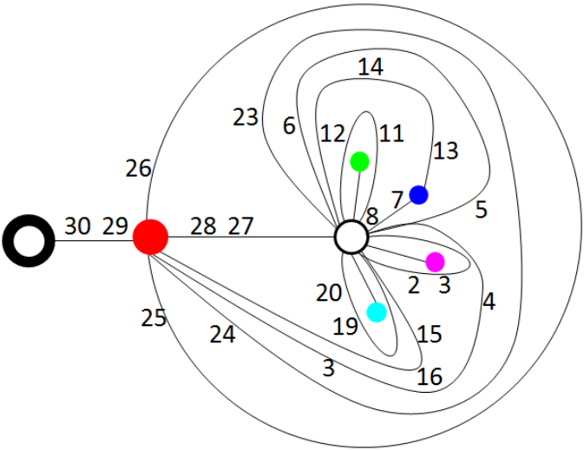
Phase 1: Existing Work
[Tor] is a Technical Report about operations on a Combinatorial Pyramid (CP).
[Tor]

Slide 8
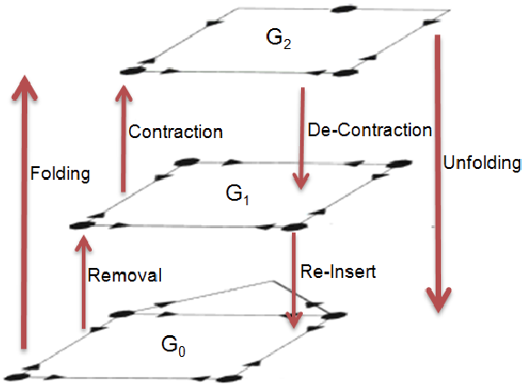
Phase 1: Existing Work
Recap: Operations on a Combinatorial Map (CM):
Remove
Contract
[Tor]

Slide 9
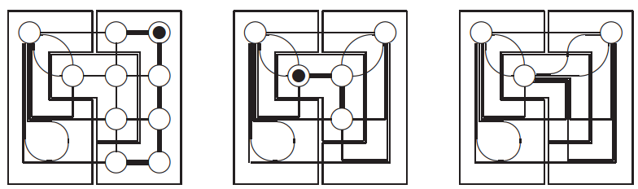
Phase 1: Existing Work
[Bru01] is an introduction to the CP. With background information an the contraction kernel.
[Bru01]

Slide 10
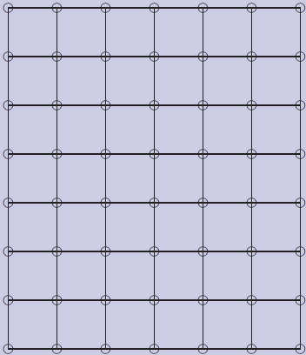
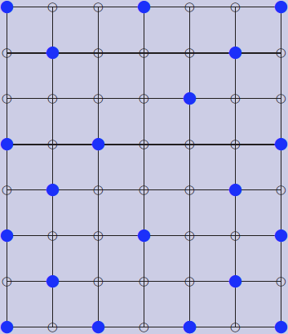
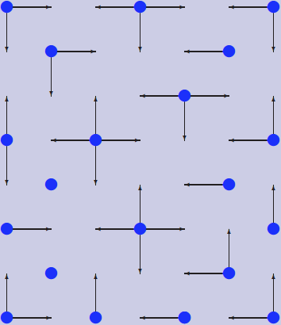
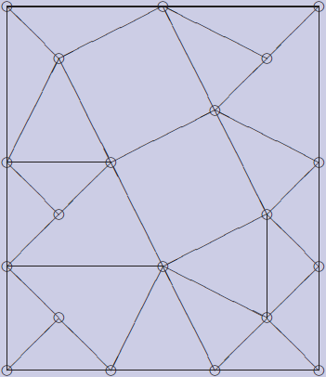
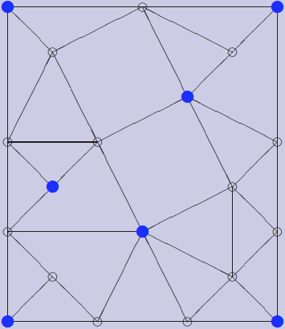
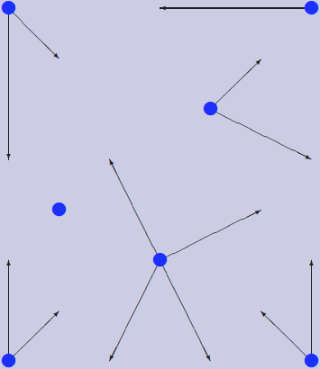
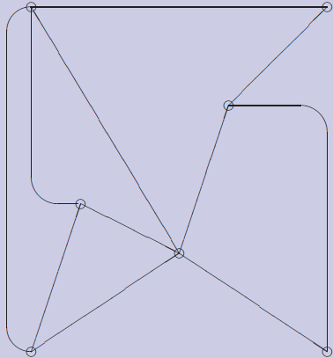
Phase 1: Existing Work
Recap: Contraction Kernel

Slide 11
Phase 1: Existing Work
[Bru03] describes contraction in parallel with contraction kernels
Recap: Problem why parallel contraction/removal is not trivial

Slide 12
Development Phases
Phase 1:
Existing Work
Phase 2:
Meet the Maps
Phase 3:
Implementation
Phase 4:
Results

Slide 13
Phase 2: Meet the Maps
I Implemented a simple python class for CM Not for computations but for representations
import CombinatorialMap
map=CombinatorialMap()
map.setSize(5, 5)
map.printNodes()

Slide 14
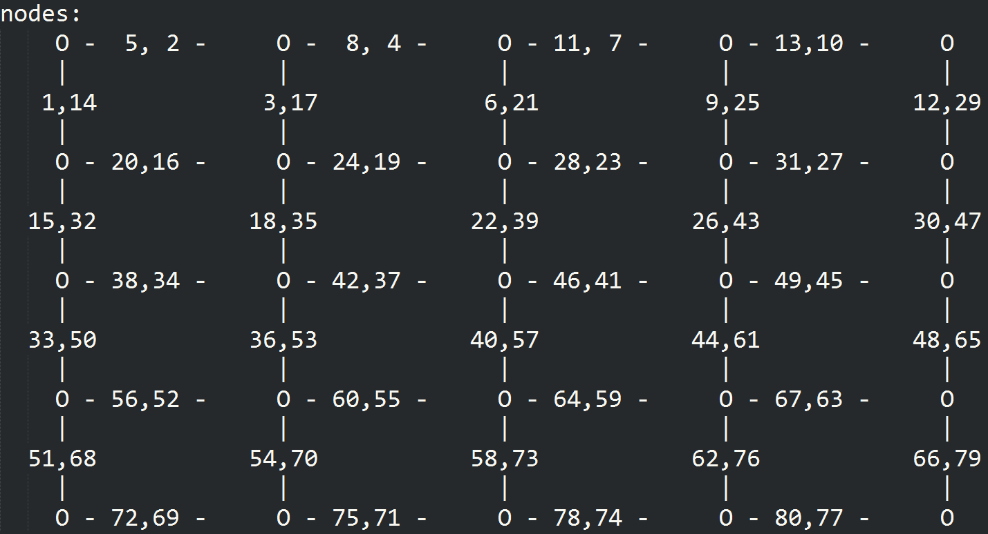
Phase 2: Meet the Maps

Slide 15
Phase 2: Meet the Maps
Also created functions to receive:
All darts with specific direction
All involutions of specific darts
The orbit of a vertex
All next darts
…

Slide 16
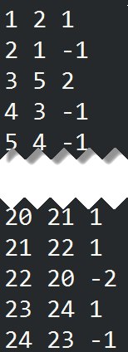
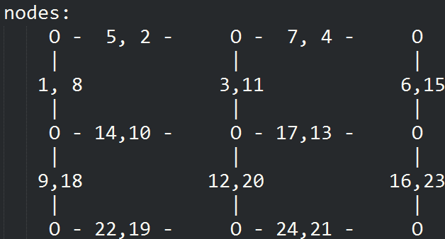
Phase 2: Meet the Maps
These are used to understand and create a CM from an image
d | s(d) | s(d)-d

Slide 17
Development Phases
Phase 1:
Existing Work
Phase 2:
Meet the Maps
Phase 3:
Implementation
Phase 4:
Results

Slide 18
Phase 3: Implementation

Slide 19
Phase 3: Implementation

Slide 20
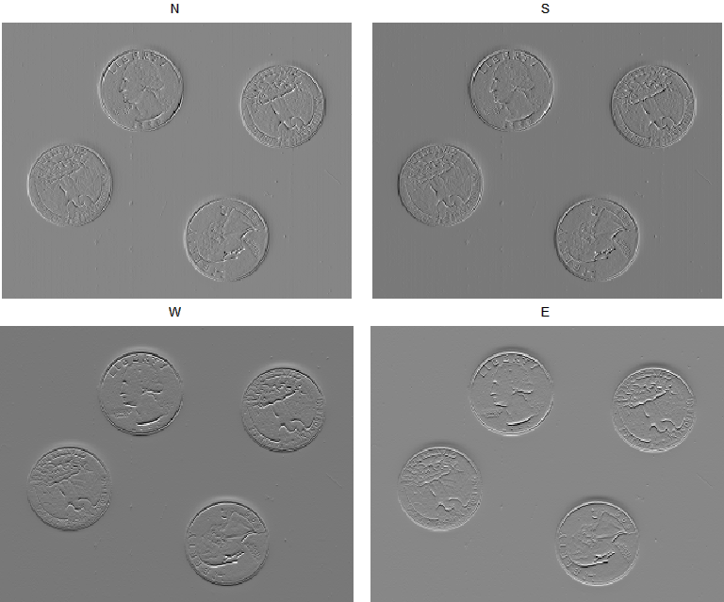
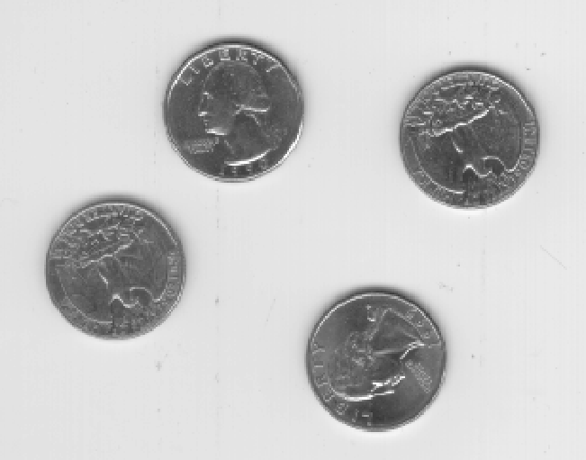
Compute Dart Values
A dart in an image is a transition from one pixel to another.
Compute from every pixel the change of the pixel value to every neighbor (N,E,S,W)

Slide 21
Phase 3: Implementation

Slide 22
Build Initial CP Level
Computation of the dart indices
Example South Indices:
Added by 4 inside the image. On the border it is only added by 3 (because the west dart is missing)
Also exceptions in the first row and the last row (missing north dart)
Additional exceptions for the corners

Slide 23
Build Initial CP Level
Computation of the next index:
one row:
repmat([2; 2; -1; -3], width-2, 1)
middle of the image:
repmat(
[next_darts_one_row; 1; 1; -2; 2; -1; -1],
height-2, 1)
Special cases for first and last row
d | s(d) | s(d)-d

Slide 24
Build Initial CP Level
Involution a
cm.involution(N) = S
cm.involution(E) = W
…
Previous Dart r
cm.prev(cm.next) = 1:num_darts

Slide 25
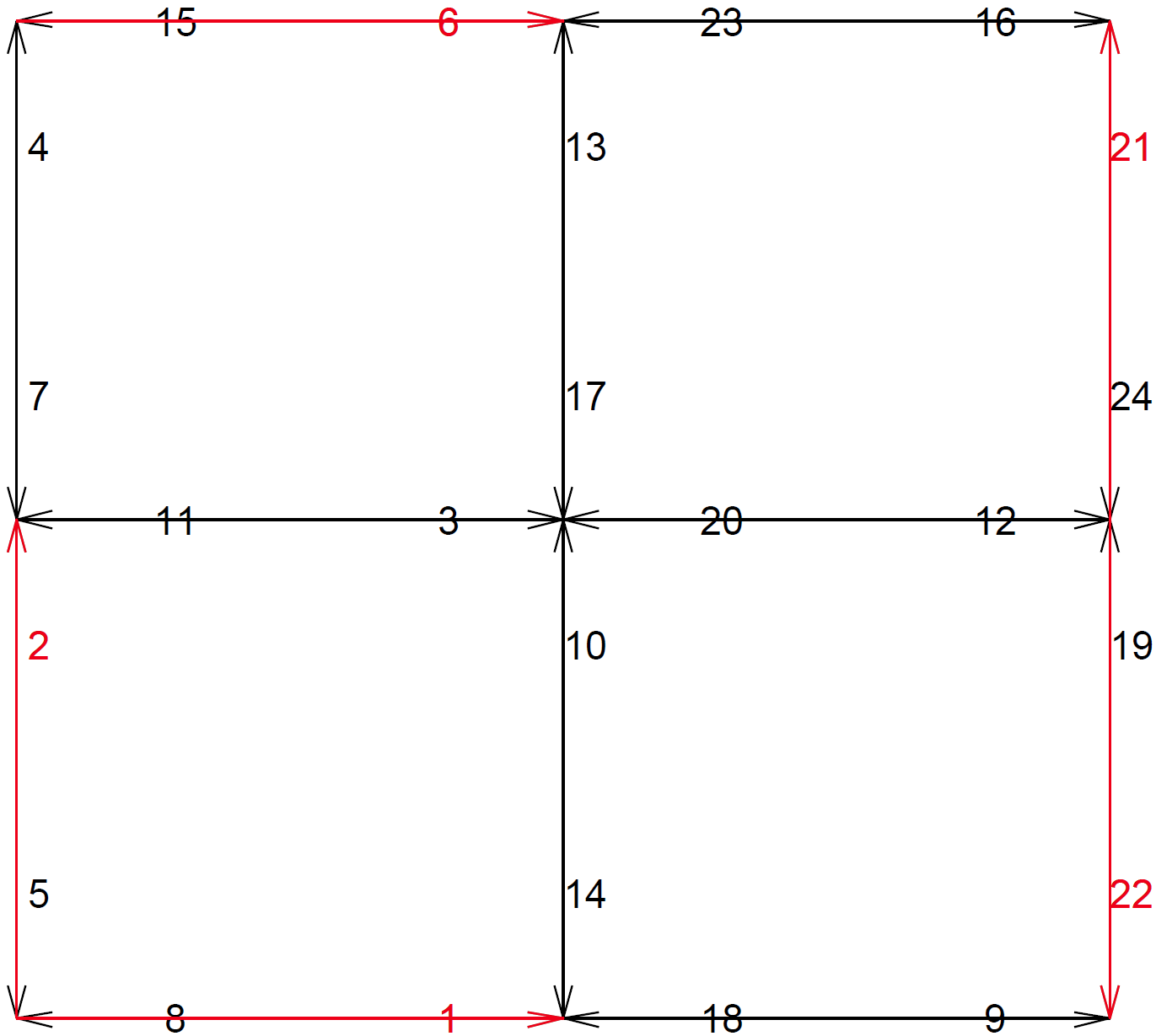
Build Initial CP Level
Some Examples:

Slide 26
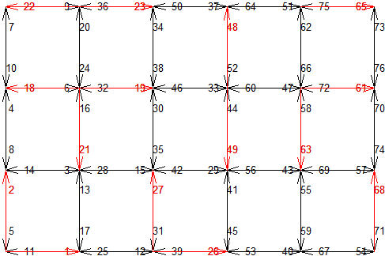
Build Initial CP Level
Some Examples:

Slide 27
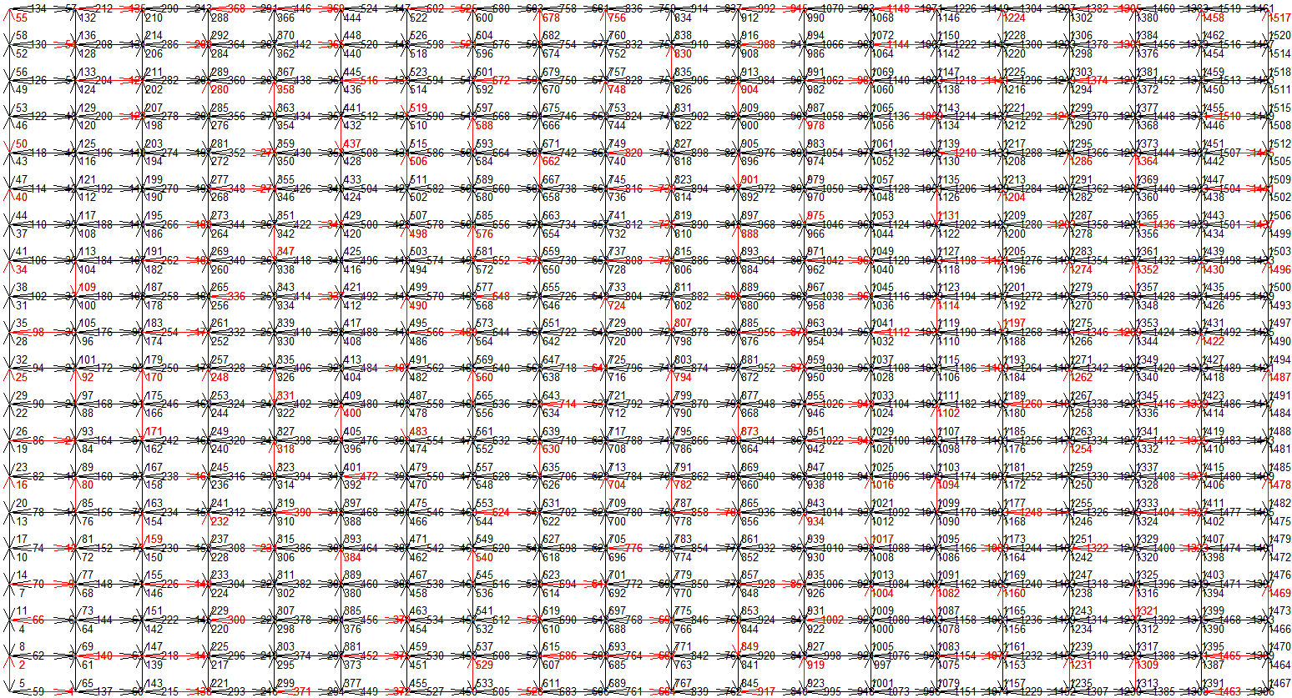
Build Initial CP Level
Some Examples:

Slide 28
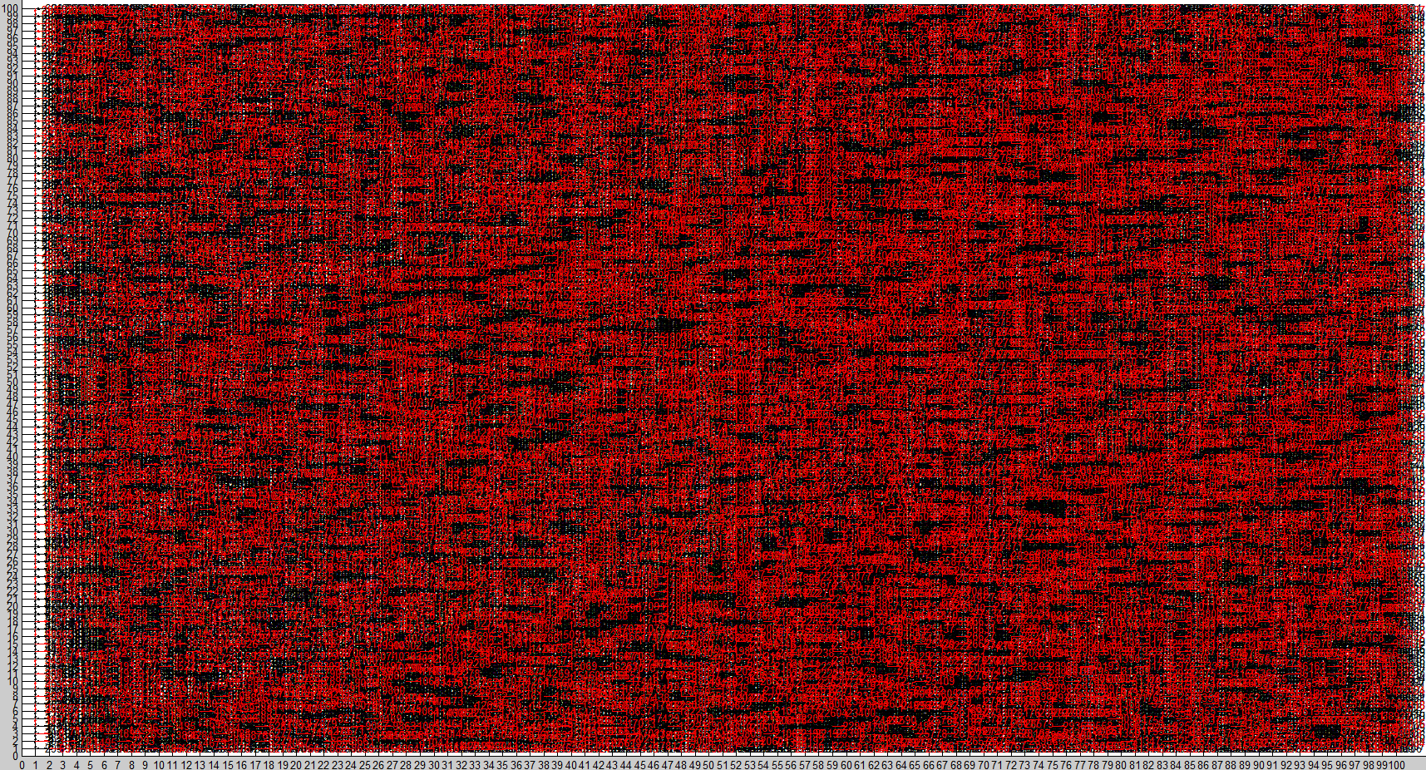
Build Initial CP Level
Some Examples:

Slide 29
Phase 3: Implementation

Slide 30
CP Creation
Contract Darts
Simplify Level
Compute Contraction Kernel

Slide 31
CP Creation
Sort the darts by its values
Add dart to contraction kernel if:
Not self loop
Not pending edge
Contract Darts
Simplify Level
Compute Contraction Kernel

Slide 32
CP Creation
Greedy: Assign next best Dart For Contraction Kernel
Contract Darts
Simplify Level
Compute Contraction Kernel

Slide 33
CP Creation
Get the involution of the dart
Contract Darts
Simplify Level
Compute Contraction Kernel

Slide 34
CP Creation
And the orbit of the involution
Contract Darts
Simplify Level
Compute Contraction Kernel

Slide 35
CP Creation
Now remove the involution of the involution orbit from the set of valid darts
Contract Darts
Simplify Level
Compute Contraction Kernel

Slide 36
CP Creation
Contract Darts
Simplify Level
Compute Contraction Kernel
Now get the orbit of the dart

Slide 37
CP Creation
Contract Darts
Simplify Level
Compute Contraction Kernel
And remove its involution (except darts that are already in the kernel)

Slide 38
CP Creation
Exceptions:
Self loops
Pending edges
Contract Darts
Simplify Level
Compute Contraction Kernel

Slide 39
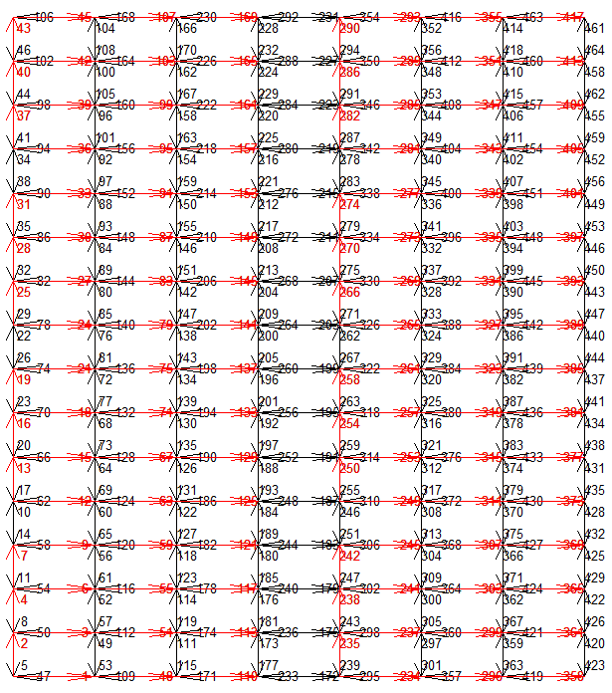

CP Creation
Examples: Checkerboard

Slide 40
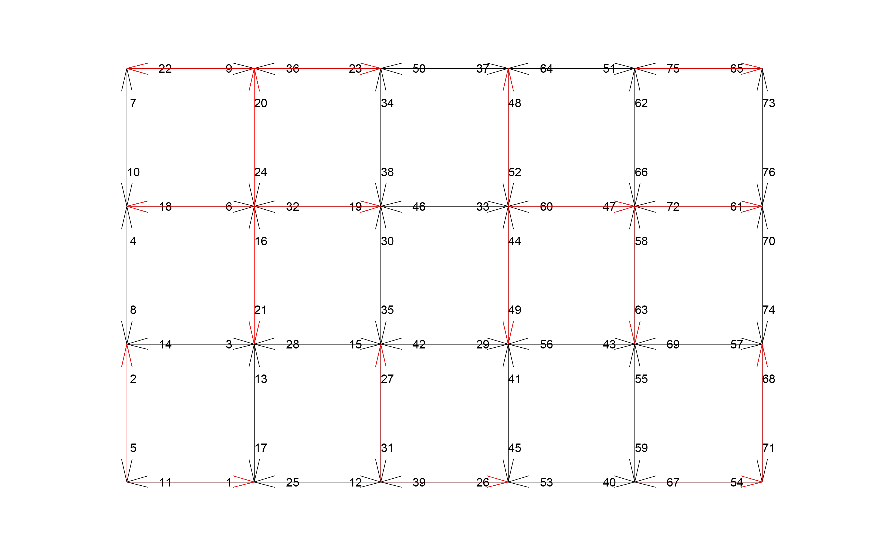
CP Creation
Examples: Random 4x6

Slide 41
CP Creation
Contract Darts
Simplify Level
Compute Contraction Kernel

Slide 42
CP Creation
Recap: Contract Darts
s
b
e
-x
d
a
x
c
darts | a | b | c | d | e | x | -x
s | x | a | d | e | -x | b | c
s’ | c | a | d | e | b | b | c
Contract Darts
Simplify Level
Compute Contraction Kernel

Slide 43
CP Creation
Recap: Contract Darts
s
s’
b
e
b
e
-x
d
d
a
x
a
c
c
darts | a | b | c | d | e | x | -x
s | x | a | d | e | -x | b | c
s’ | c | a | d | e | b | b | c
Contract Darts
Simplify Level
Compute Contraction Kernel

Slide 44
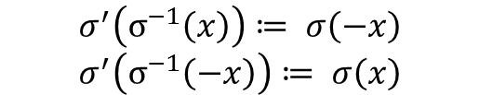
CP Creation
Recap: Contract Darts
s
s’
b
e
b
e
-x
d
d
a
x
a
c
c
darts | a | b | c | d | e | x | -x
s | x | a | d | e | -x | b | c
s’ | c | a | d | e | b | b | c
Contract Darts
Simplify Level
Compute Contraction Kernel
$$σ^{′}\left(σ^{−1}\left(x\right)\right)≔ σ\left(−x\right)$$
$$σ^{′}\left(σ^{−1}\left(−x\right)\right)≔ σ\left(x\right)$$

Slide 45
CP Creation
Contract Darts
Simplify Level
Compute Contraction Kernel

Slide 46
CP Creation
When contracting darts double edges and self-direct-loops are created. By removing these darts the pyramid is easier to read and faster to compute.
Contract Darts
Simplify Level
Compute Contraction Kernel

Slide 47
CP Creation
Check if the face of a dart has less than 2 darts:
Get face of this dart
Contract Darts
Simplify Level
Compute Contraction Kernel

Slide 48
CP Creation
Check if the face of a dart has less than 2 darts:
More than 2 darts!
Add all darts as valid
Contract Darts
Simplify Level
Compute Contraction Kernel

Slide 49
CP Creation
Check if the face of a dart has less than 2 darts:
Get face of this dart
Contract Darts
Simplify Level
Compute Contraction Kernel

Slide 50
CP Creation
Check if the face of a dart has less than 2 darts:
Contract Darts
Simplify Level
Compute Contraction Kernel
Number of darts in face is 2
→ can be removed!

Slide 51
CP Creation
Special cases for removal:
Self-Direct-Loops (2 cases)
Contract Darts
Simplify Level
Compute Contraction Kernel

Slide 52
Development Phases
Phase 1:
Existing Work
Phase 2:
Meet the Maps
Phase 3:
Implementation
Phase 4:
Results

Slide 53
Phase 4: Results
DEMO

Slide 54
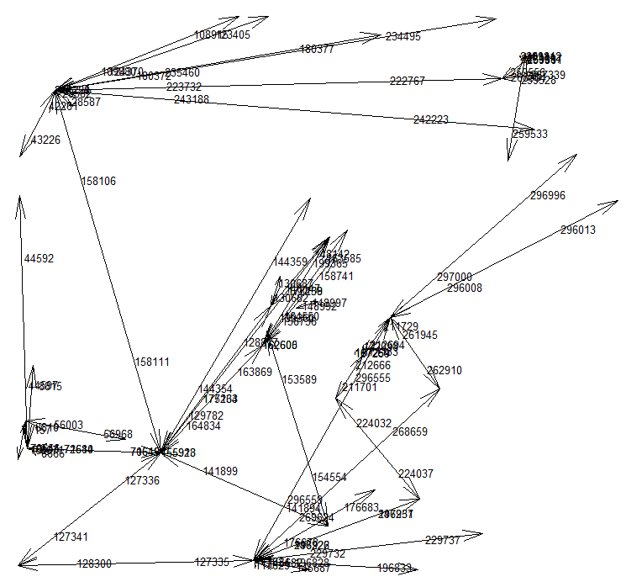
Phase 4: Results
Some costly examples:

Slide 55
Phase 4: Results
Some costly examples:
Computed dart values in t = 0.059775
Build the first level in t = 0.086759
Pyramid level 1:
Computing contraction darts in t = 2.9207
Contracting darts in t = 266.4844
Simplify darts in t = 106.7169
Pyramid level 2:
Computing contraction darts in t = 0.75872
Contracting darts in t = 12.5819
Simplify darts in t = 15.538
Pyramid level 3:
Computing contraction darts in t = 0.19017
Contracting darts in t = 1.3143
Simplify darts in t = 2.773
Pyramid level 4:
Computing contraction darts in t = 0.039157
Contracting darts in t = 0.11308
Simplify darts in t = 0.55075
Pyramid level 5:
Computing contraction darts in t = 0.012458
Contracting darts in t = 0.022358
Simplify darts in t = 0.1428
Pyramid level 6:
Computing contraction darts in t = 0.005318
Contracting darts in t = 0.0073207
Simplify darts in t = 0.040723
Pyramid level 7:
Computing contraction darts in t = 0.0037845
Contracting darts in t = 0.0043555
Simplify darts in t = 0.014865
Pyramid level 8:
Computing contraction darts in t = 0.0023793
Contracting darts in t = 0.0060671
Simplify darts in t = 0.0055569
Pyramid level 9:
Computing contraction darts in t = 0.0022346
Contracting darts in t = 0.0008062
Simplify darts in t = 0.00072034

Slide 56
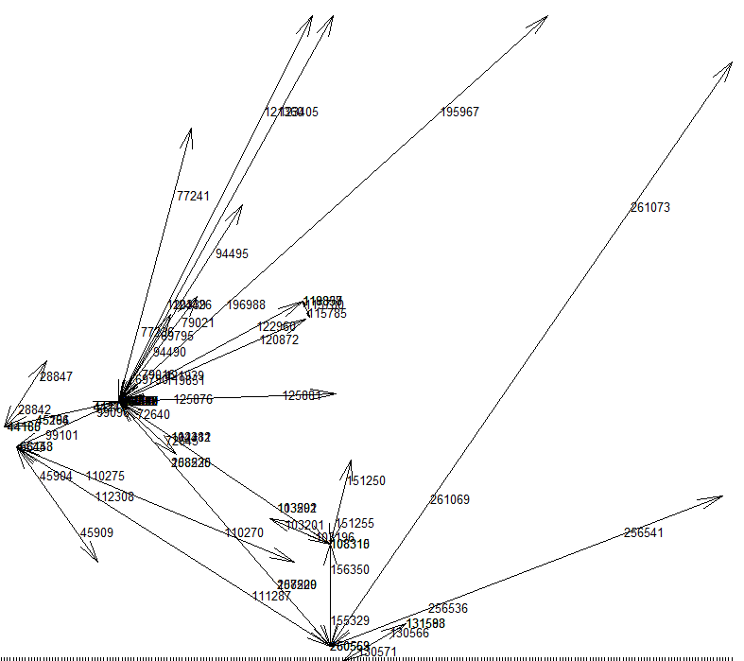
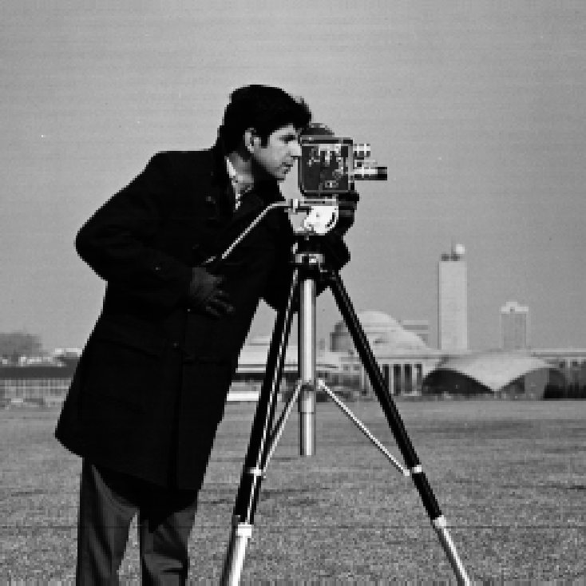
Phase 4: Results
Some costly examples:

Slide 57
Phase 4: Results
Some costly examples:
Computed dart values in t = 0.0062779
Build the first level in t = 0.020736
Pyramid level 1:
Computing contraction darts in t = 2.968
Contracting darts in t = 181.0094
Simplify darts in t = 76.553
Pyramid level 2:
Computing contraction darts in t = 0.74004
Contracting darts in t = 16.89
Simplify darts in t = 18.8009
Pyramid level 3:
Computing contraction darts in t = 0.25653
Contracting darts in t = 2.3072
Simplify darts in t = 4.9443
Pyramid level 4:
Computing contraction darts in t = 0.10794
Contracting darts in t = 0.32571
Simplify darts in t = 1.1495
Pyramid level 5:
Computing contraction darts in t = 0.036567
Contracting darts in t = 0.093726
Simplify darts in t = 0.38555
Pyramid level 6:
Computing contraction darts in t = 0.01044
Contracting darts in t = 0.0233
Simplify darts in t = 0.078444
Pyramid level 7:
Computing contraction darts in t = 0.0048791
Contracting darts in t = 0.0070267
Simplify darts in t = 0.029019
Pyramid level 8:
Computing contraction darts in t = 0.0046073
Contracting darts in t = 0.0098711
Simplify darts in t = 0.0090754
Pyramid level 9:
Computing contraction darts in t = 0.0037574
Contracting darts in t = 0.0046855
Simplify darts in t = 0.0045636
Pyramid level 10:
Computing contraction darts in t = 0.0030545
Contracting darts in t = 0.00087896
Simplify darts in t = 0.0007055

Slide 58
Literatur
[Tor] Torres, Fuensanta, and Walter G. Kropatsch. "Canonical Encoding of the Combinatorial Pyramid.“
[Bru01] Brun, Luc, and Walter Kropatsch. "Introduction to combinatorial pyramids." Digital and image geometry. Springer Berlin Heidelberg, 2001.
[Bru03] Brun, Luc, and Walter Kropatsch. "Contraction kernels and combinatorial maps." Pattern Recognition Letters 24.8 (2003): 1051-1057.

